Slide 1

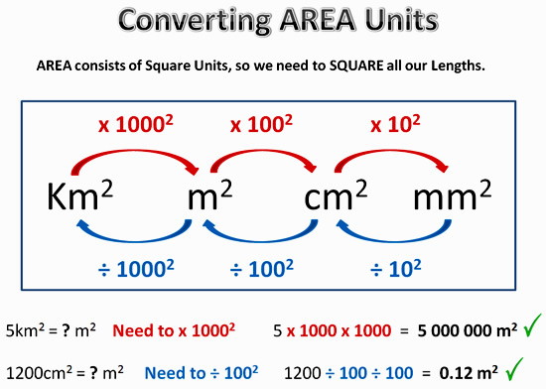
My Measurement Interactive Notebook
Name
Class
Teacher Mr Evans
Term 1 Semester 1
1

Slide 2
Contents
Glossary or Formula Page
Page
Date
Description
2
3

Slide 3
Tasks
24
7
30
Essential Question
Questions
Notes
Summary
6
7

Slide 4

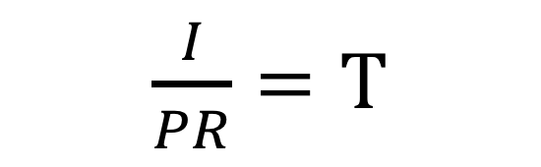

24
7
30
Date
Topic : Test Revision
EQ – What do we need to know for the test?
$\frac{I}{PT}=$R
$\frac{I}{RT}=P$
$\frac{I}{PR}=T$

Slide 5
24
7
30
Date
Topic : Test Revision
EQ – What do we need to know for the test?

Slide 6
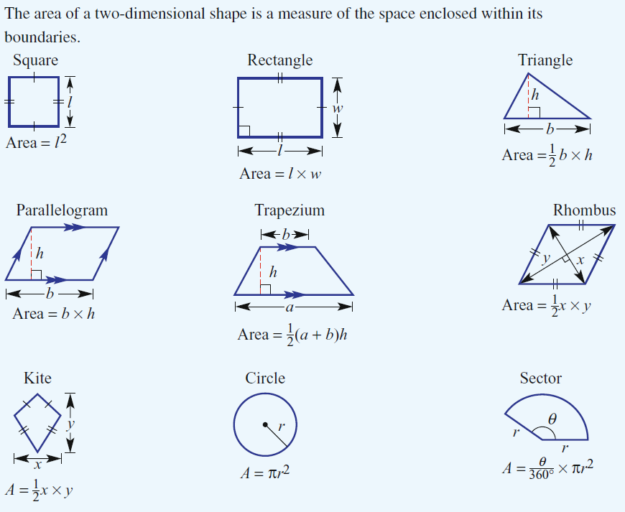
24
7
30
Date
Topic : Test Revision
EQ – What do we need to know for the test?

Slide 7
8cm
Area A = 8 x 5
= 40cm²
A
5cm
Area B = 11 x 2
= 22cm²
B
11cm
Total Area = 40 + 22
= 62cm²
2cm

Slide 8
Volume of Cuboids
A cuboid is a 3-dimensional object made up of a rectangles and squares
Volume = height x width x depth
Units: cm³, m³, mm³, km³, etc
height
depth
width

Slide 9
24
7
30
Date
Topic : Test Revision
EQ – What do we need to know for the test?
Remember: Volume = Height x Width x Depth
Surface Area = Face 1 Length x Width x 2
Face 2 Length x Width x 2
Face 3 Length x Width x 2
Add the areas together.
To find the area of compound shapes, split them up into their composite shapes.
Find the area of each shape, then add them together

Slide 10
24
7
30
Date
Topic : Test Revision
EQ – What do we need to know for the test?

Slide 11
24
7
30
Date
Topic : Test Revision
EQ – What do we need to know for the test?
Find the volume of the following shapes.

Slide 12
Notes Review
24, 7 ,30
Date
Title
Essential question
Notes complete
Notes complete with colour and diagrams
Questions completed
Contents page filled in
Formula page filled in

Slide 13
Homework
Review your notes and write a summary answering the essential question.

